Slide 1
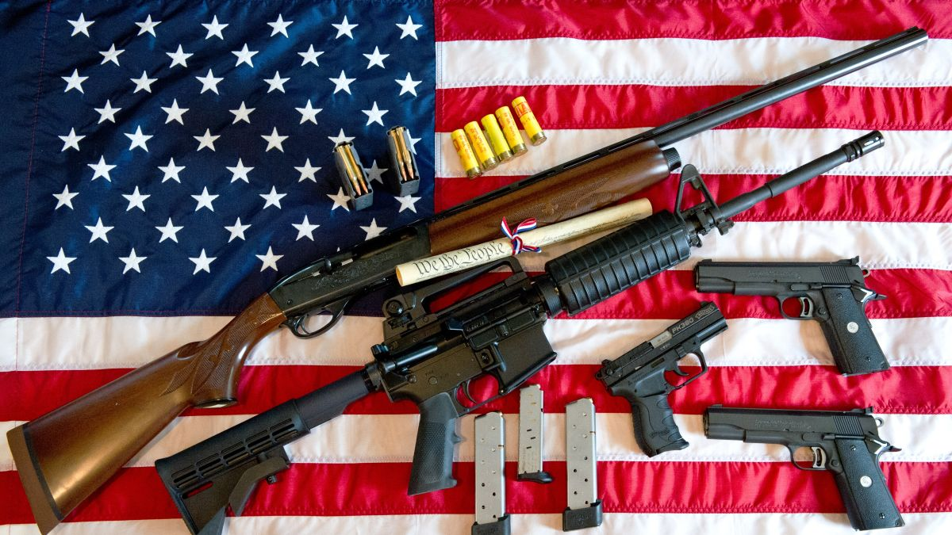

Gun Violence in America
By - Anshu Singh

Slide 2
Application Area
Help cops to prepare before any incident happen and find pattern.
Making/Modifying Law where it is required the most.

Slide 3
Data
Incident id
Date
State
City_or_country
Address
N_killed
N_injured
Incident_url
Source_url
incident_url_fields_missing
congressional_district
gun_stolen
gun_type
incident_characteristics
Latitude
location_description
Longitude
n_guns_involved
Notes
participant_age
participant_age_group
participant_gender
participant_name
participant_relationship
participant_status
participant_types
Sources
state_house_district
state_senate_district

Slide 4
Task
Which states are worst affected by the gun violence?
Is there any particular month when gun-violence increases? Can we detect any pattern in it?
Can we say that number of guns involved is proportional to the number of killing? In other words, can we say that if number of guns increases, tendency of incident to become a Mass shooting increases?
What percentage of people get killed in a particular state if there is gun-violence incident?Does this indicate that with the increase in incident, number of injuries and killings increase too?

Slide 5
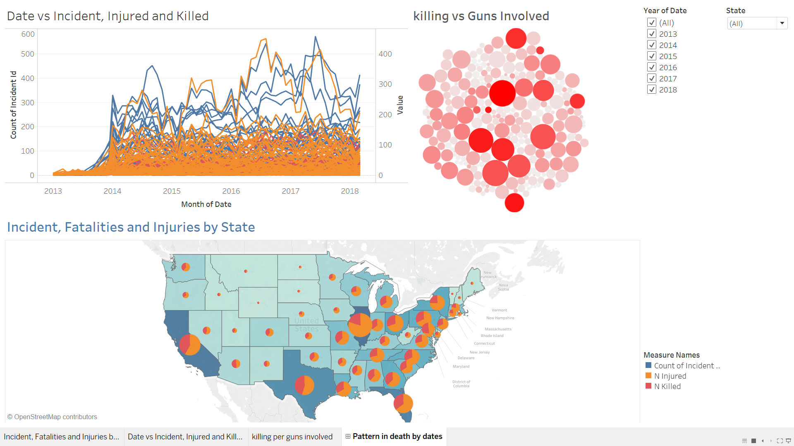
DATA VISUALIZATION
Notes:
Tableau - https://public.tableau.com/profile/anshusingh#!/vizhome/TrendinGunViolenceUSA/Patternindeathbydates

Slide 6
Thank You !

